Slide 1
Final Presentation
Pedro E Rodriguez

Slide 2
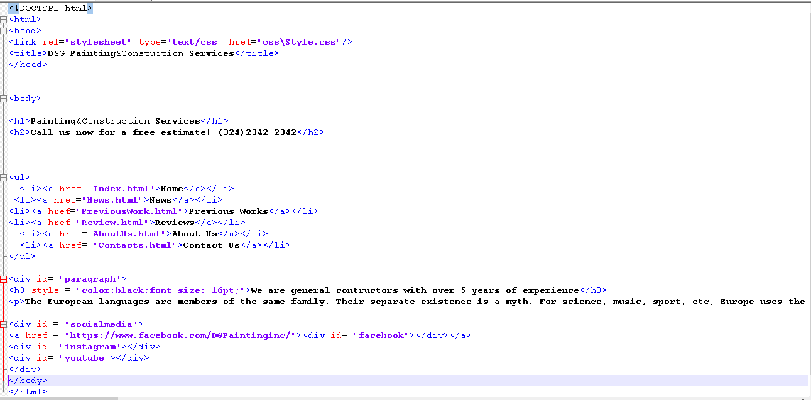
Start by creating the index or Home Page

Slide 3
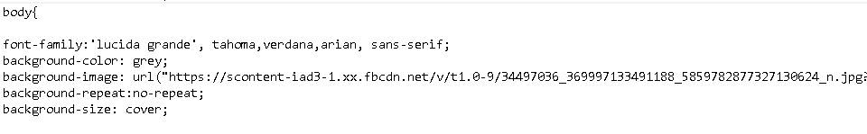
Creating the Style sheet or css
CSS stands for Cascading Style Sheets.
CSS describes how HTML elements are to be displayed on screen, paper, or in other media.
CSS saves a lot of work. It can control the layout of multiple web pages all at once.
css\Style.css

Slide 4
Creating different pages
For example my PreviousWork.html has a slide show:
How to do it?
First create different divs to place each element.
Second, create the functions using javascript so you will be able to
Switch containers.
Code:
..\..\..\Users\Student\Desktop\Actual Class Folder\creatingdivs.txt
..\..\..\Users\Student\Desktop\Actual Class Folder\Javascript.txt

Slide 5

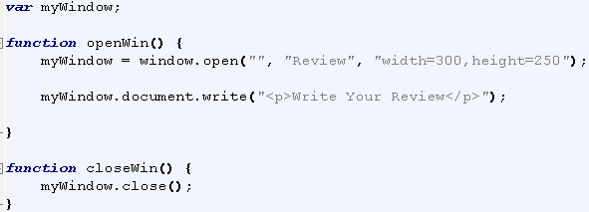
Creating my Review.html Page
For this one I just created two button that open up a window where you can write a review. This can be implemented in the future, its just an idea.
I just created the button using html and creating the design in the css, plus a bit of javascript to open the new window.

Slide 6
Creating the Contact.html Page
For this page I simply used html code to create two divs, one that contains a picture and the other one contains a table with all the text boxes for the inputs.
Second, by using php code, I connected to the database and save all the inputs into a table that we previously created in mySql.
The codes are here:
Html code:htmlcode.txt
Php code:process1.php

Slide 7
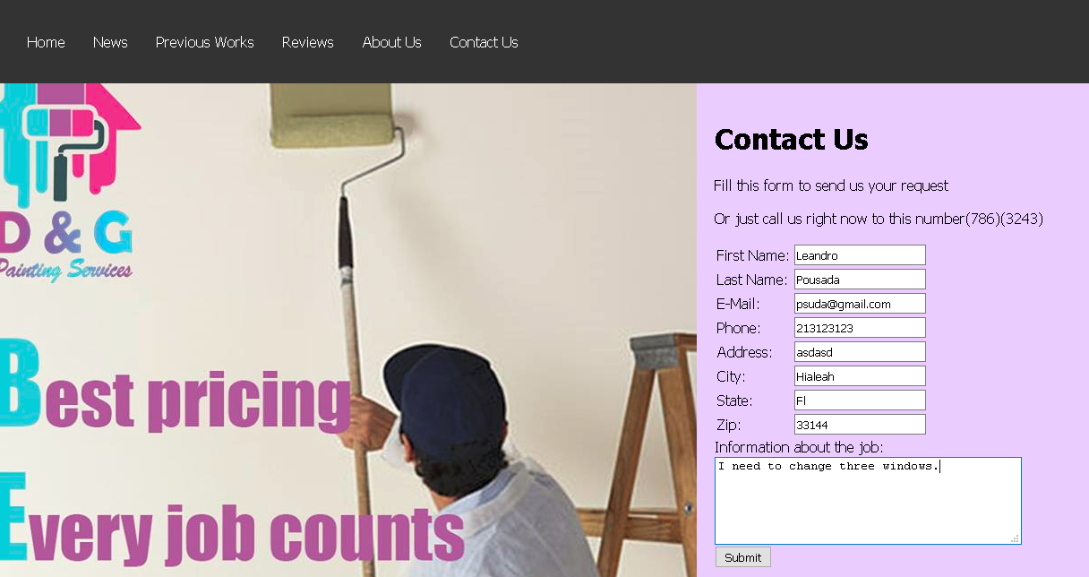
Inserting data into table:

Slide 8
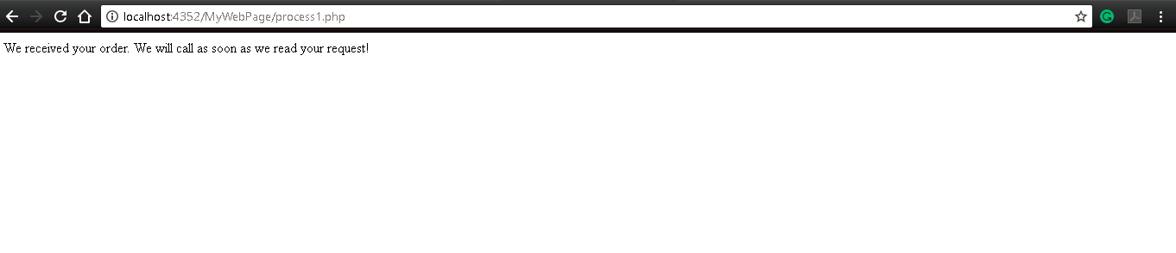
After submitting data

Slide 9
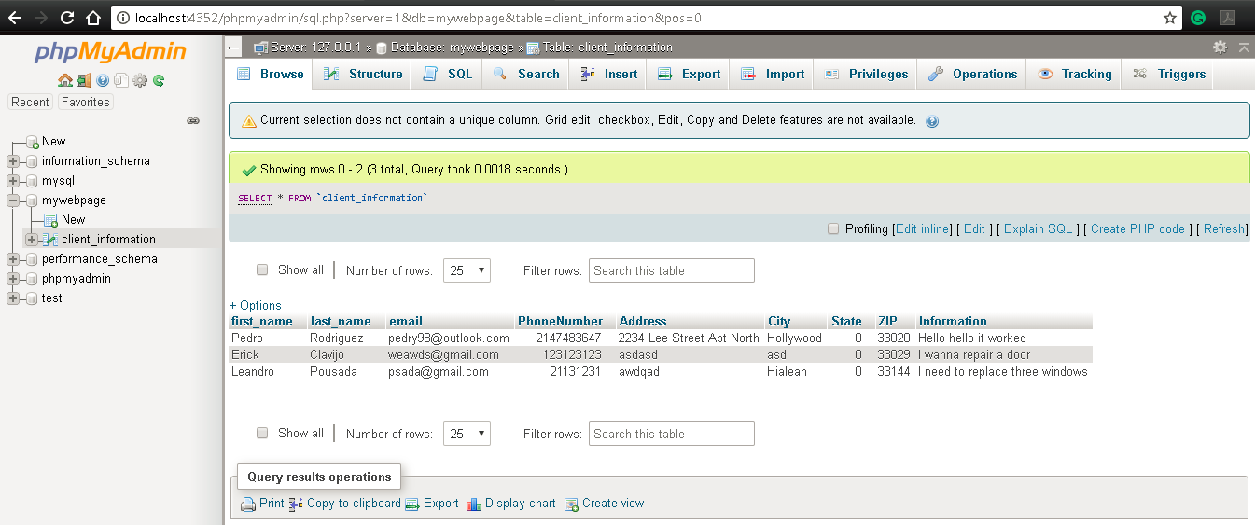
How the table looks like after:

Slide 10
Basic Tips for making a good website
1- Your Pages Must Load Fast
2-Your Pages Should Only Be as Long as They Need to Be
3-Your Pages Need Great Navigation
4-You Should Use Small Images
5-You Should Use Appropriate Colors
6-Your Links Must Work
7-You Should Avoid Saying Just Click Here
8-Your Pages Should Have Contact Information

